Slide 1
Slide 1
Intermediate HPC
Introduction to Unix for HPC

Slide 2
Slide 2
What is HPC?
HPC, or high-performance computing, refers to the application of supercomputers or clusters of computers to computational problems that typically arise through scientific inquiry
HPC is useful when a computational problem:
Is too large to solve on a conventional laptop or workstation (because it requires too much memory or disk space) or
Would take too long (because the algorithm is complex, the dataset is large, or data access is slow) or
Are too many – High Throughput Computing

Slide 3
Slide 3
Parallelism on HPC
HPC systems often derive their computational power by exploiting parallelism
Programs for HPC systems must be split up into many smaller “sub-programs“ which can be executed in parallel on different processors
HPC systems can offer parallelism at a much larger scale, with 100’s or 1000’s, or (soon) even millions of tasks running concurrently.
Writing parallel software can be challenging, and many existing software packages do not already support parallelism & may require development.
NOTE: Many tasks cannot be parallelised
Notes:
Parallelism
HPC systems often derive their computational power from exploiting parallelism , meaning the ability to work on many computational tasks at the same time. An application or algorithm that does not exploit parallelism is usually called sequential or serial, because it has to execute tasks individually in a sequence or series.
Modern laptops and desktops have some limited support for parallelism because of the popularity of multi-core processors. These processors can run a handful of concurrent tasks, which improves the performance of multi-tasking, e.g. running your web browser, word processor, email client, and other desktop applications at the same time.
However, HPC systems typically offer parallelism at a much larger scale, with hundreds, thousands, or (soon) even millions of tasks running concurrently. Parallelism at this scale poses many challenges. Some algorithms have difficult-to-remove bottlenecks, or serialization points, where a single task must complete before any other tasks can begin. In other cases, tasks may need to share the same data or modify data in a carefully coordinated order. Writing parallel software can be challenging, and many existing software packages do not already support parallelism. Sometimes “parallelizing” an existing software package or algorithm requires a substantial investment in research and development.
In other cases, computational problems parallelize easily, because the nature of the problem is such that it can be broken into many small task that are independent of each other. A problem of this type is sometimes called “embarrassingly parallel,” because it is so straightforward or simple to implement that it does not require substantial research

Slide 4
Slide 4
Reasons to use HPC
You have a program that can be recompiled or reconfigured to use optimized numerical libraries that are available on HPC systems but not on your own system.
HPC applications are already installed on the HPC machines which is a non-trivial task
You have a "parallel” problem, e.g. you have a single application that needs to be rerun many times with different parameters.
You have an application that has already been designed with parallelism
To make use of the large memory available
Our facilities are reliable and regularly backed up
Notes:
You have a program that can be recompiled or reconfigured to use optimized numerical libraries that are available on NCI systems but not on your own system.
You want to run a software package that is impractical to install or support on your own system.
You have a "parallel” problem: for instance, you have a single application that needs to be rerun many times with different parameters.
You have a serial application that you would like to run faster, and you are prepared to invest in rewriting or redesigning it to expose more parallelism; you may also need access to a parallel platform to test and debug the program during development.
You have an application that has already been designed with parallelism and you would like to put it into production on NCI's cluster.
You have an application that requires a large allocation of memory and it can fit on NCI's large-memory nodes, which have 64GB or 128GB of system memory.
You have an I/O-intensive application that will benefit from NCI's high-performance file-systems, which can access data at much higher rates than conventional laptops and workstations

Slide 5
Slide 5
When not to use HPC?
You have a single threaded job which will only run one job at a time (typical of MatLab users)
You rely on Databases
You have a lot of data to transfer between your local machine and the HPC on a continuous basis (e.g. per job)
You need to have a GUI to interact with your program

Slide 6
Slide 6
HPC machines
System | Memory Architecture | Cores | Nodes | Memory
Octane (training machine) | Distributed | 48 | 3 | 48GB
Orange | Distributed | 1,600 | 100 | 8TB
NCI – (Raijin) | Distributed | 57,472 | 3592 | 158TB

Slide 7
Slide 7
The typical HPC workflow
In HPC we talk about jobs, these are simply commands we wish to run and requests for resources (e.g. compute time, disk space, memory requirements, setup of s/w env’s etc.)
Generally time consuming & resource intensive.
Jobs are typically run non-interactively,
Can be run interactively for testing purposes
We add our jobs to a queue.
When machines have free resources jobs run
Once jobs are complete, we can inspect their output.

Slide 8
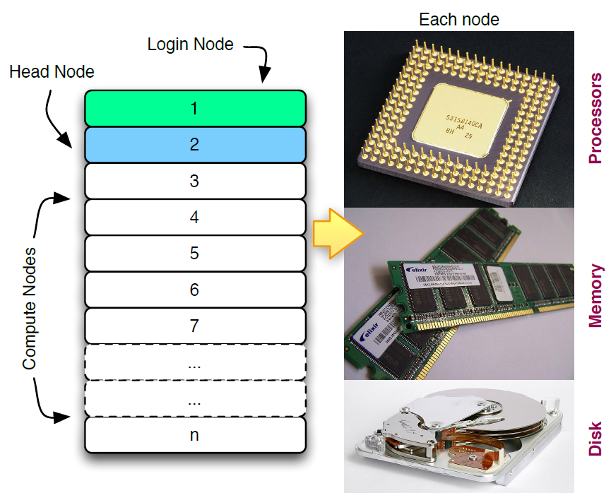
Slide 8
The HPC “Cluster”

Slide 9
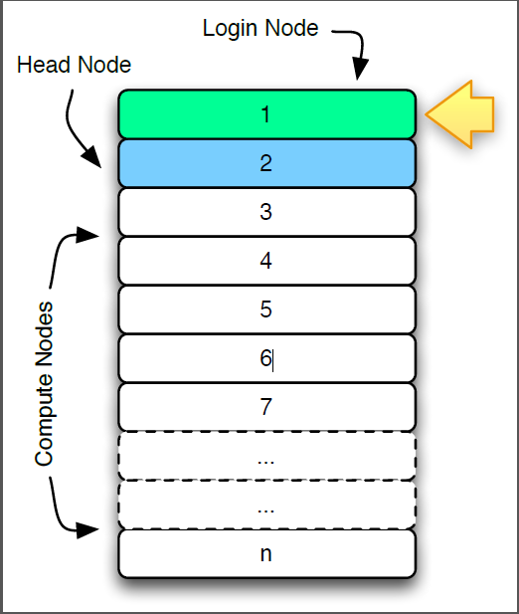
Slide 9
The Login Node
Login Node
Interactive programs
SSH sessions
Testing
Compiling

Slide 10
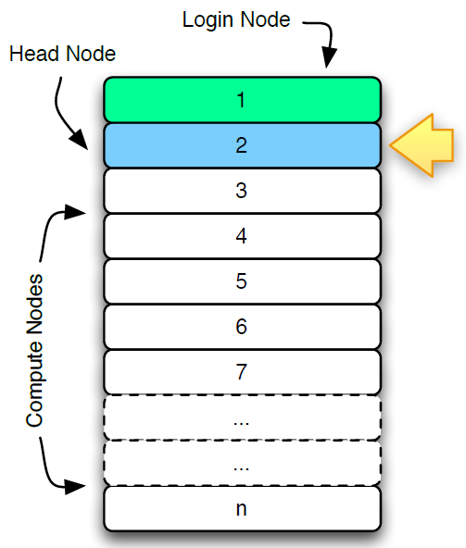
Slide 10
The Head Node
Head Node
Queuing jobs

Slide 11
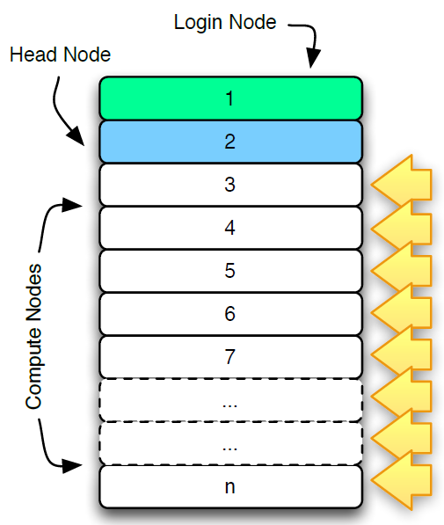
Slide 11
Compute Nodes
These nodes run your jobs
Managed by the scheduler
Typically you won’t interact with the nodes directly
Some users may need to!

Slide 12
Slide 12
Queuing Systems
Portable Batch System (PBS) is the name of computer software that performs job scheduling. Its primary task is to allocate computational tasks, i.e., batch jobs, among the available computing resources.
The following versions of PBS are currently available:
OpenPBS
TORQUE
PBS Professional (PBS Pro)
ANU PBS
Guide to PBS: http://hpc.sissa.it/pbs/pbs.html

Slide 13
Slide 13
Queuing Systems cont.
Another popular batch system is SLURM (Simple Linux Utility for Resource Management )
Open source, fault-tolerant, and highly scalable cluster management and job scheduling system for large and small Linux clusters.
Very useful for use on clusters
Platform Tools used by IBM
Used by many supercomputers, e.g. TERA 100 at CEA (Europe’s most powerful supercomp.)
Many banks and commercial entities using batch systems

Slide 14
Slide 14
ANU PBS vs PBS Pro
ANU PBS is a customised version of PBS based on OpenPBS 2.3 maintained by ANU
Details of ANU PBS modifications are found here:
http://anusf.anu.edu.au/~dbs900/PBS/local_modifications.html
Batch System | ANU PBS | PBS PRO
Machines using | Raijin | Orange & Octane
Code Base | OpenPBS 2.3 | PBS Professional
Licence | ANU Licence | Altair Licence

Slide 15
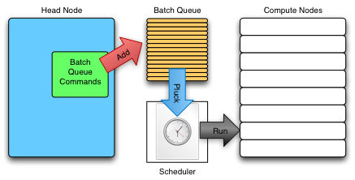
Slide 15
The Batch Queuing System

Slide 16
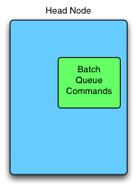
Slide 16
Batch Queuing component
The batch system is a normal program
Lets you add and remove jobs from the queue and monitor the queue
Script/command line driven

Slide 17
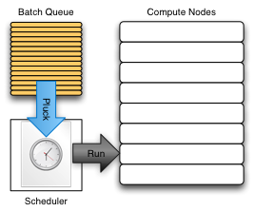
Slide 17
The Scheduler component
Allocates jobs to compute nodes
Optimizes usage of resources
“Optimize” can mean many things
Non-trivial
Never interact with directly

Slide 18
Slide 18
PBS Pro Commands
In order to use the batch system productively, we need to know how to perform three actions:
Add a job to the queue
Remove a job from the queue
See where our job is in the queue
Command | Description
qsub <job-script> | Submit a job (add to queue) Returns a <job-number>
qdel <job-number> | Delete job (remove from the queue)
qstat <job-number> | Monitor jobs
qalter <job-number> | Modifies the attributes of the job or jobs

Slide 19
Exercise 1 Monitoring the queue with qstat
Command | Description
qstat -a | List all jobs in the queue
qstat -u <username> | List all jobs of a particular user
qstat -f <job-number> | Show detailed information about a job
nqstat | ANU PBS only! Shows detailed information about all jobs

Slide 20
Slide 20
All about Modules
What do Modules do?
Set up the environment for a software package
Adds paths to executables to $PATH
May change other shell variables, and/or load other modules.
Allow you to have different versions of the same software package, e.g. load the Intel compilers v23 with module load intel/12, or if you require an older version, you can load it with module load intel/9

Slide 21
Slide 21
All about Modules (cont.)
Things to know about modules
No default module loaded when you login. You can change this by adding lines to your .bashrc file (BASH users) or similar for other Shells
Modules exist for many packages but not for all!
Some modules exclude each other, e.g.
You can’t load Intel compilers v8 & v9. You can only load one.
You can only load 1 MPI (e.g. MPT or Intel or OpenMPI)

Slide 22
Slide 22
Module Commands
Command | Description
module avail | Will list all available module files in the current MODULEPATH
module load/unload | Will load/unload a modulefile into the shell environment e.g. module load mpt/2.06
module list | List all loaded modules
module show [modulefile] | Will show information about the modulefile

Slide 23
Slide 23
Add a job to the queue
To add a job to the queue, we write a job script. A job script is a simply a script.
The # symbol signifies a comment for the Shell
It has some special comments that pass info to PBS Pro.
#PBS is a keyword for PBS and specifies that this line is for PBS. The Shell will ignore it
When we want to queue the job, we pass its filename as a parameter to qsub, e.g.
qsub <job-script>
The batch queuing system will return a number that uniquely identifies the job.

Slide 24
Slide 24
Useful Environment Variables
These are available in the context of your job script.
Command | Description
PBS_O_WORKDIR | The directory the job was submitted from
PBS_JOBID | The job number given when the job was submitted

Slide 25
Slide 25
A sample PBS job script
NOTE: This script will not run on Orange as resources are assigned via Groups on Orange, not via projects
#!/bin/bash
# Request resources
# * 10 minutes wall time to run
#PBS -l walltime=00:10:00
# * 1 node, 1 processor
#PBS -l nodes=1:ppn=1
# * 100 megabytes physical memory allocated to job
#PBS -l mem=100mb
# Specify a project code (for accounting)
#PBS -P a40
cd $PBS_O_WORKDIR # Specify the job to be done date sleep 10 date

Slide 26
Slide 26
You’ve got mail!
# Set email address
#PBS -M fred@intersect.org.au
# Send an email when jobs
# begins (b), gets aborted (a)
# and ends (e)
#PBS -m abe

Slide 27
Exercise 2 Create a script and submit a very simple job
Command | Description
#PBS | #PBS is a keyword for PBS and specifies that this line is for PBS. The Shell will ignore it
# | Signifies a comment for the Shell, e.g. # Next line will create a job
qsub | Submit a job to PBS
qstat | List jobs in the queue
cat <filename> | Print a file to the terminal (catenate)
less <filename> | Like cat, but less at a time
nano <filename> | Will open file <filename> in a text file editor
Sample PBS Script | http://www.intersect.org.au/orange-handbook

Slide 28
Exercise 3 Create another script and submit a more realistic sample job
Command | Description
#PBS | #PBS is a keyword for PBS and specifies that this line is for PBS. The Shell will ignore it
# | Signifies a comment for the Shell, e.g. # Next line will create a job
qsub | Submit a job to PBS
qstat | List jobs in the queue
nano <filename> | Will open file <filename> in a text file editor
module load <module_name> | Loads a software module on the HPC machine

Slide 29
Slide 29
Job limits on Orange
200 hours of walltime
64GB of memory per standard node, e.g. 128GB for 2 nodes etc.
256GB of memory per large memory nodes
NOTE: If you grab a node with 64GB, you can effectively use about 60GB as the OS uses memory

Slide 30
Slide 30
Priorities of Jobs
In order of importance, jobs are prioritised in this order:
Resources available to the project
Walltime
Number of jobs (fair share)

Slide 31
Slide 31
Best strategy
Submit jobs constantly/daily
Have about 10-20 jobs in the machine
Be realistic with walltime
Don’t ask for resources you don’t need!

Slide 32
Slide 32
NCI Facilities
Disk Type | Disk Usage
NCI Raijin | 2 sockets with 8-core CPU’s = 16 cores 57,472 cores in the compute nodes Approximately 160 TBytes of main memory; Infiniband FDR (fourteen data rate) interconnect Approximately 10 PBytes of usable fast file system (for short-term scratch space).

Slide 33
Slide 33
NCI Facilities
Raijin
96.5% of Nodes have 24Gb/node
3.2% of Nodes have 48Gb/node
0.3% of Nodes have 96Gb/node

Slide 34
Slide 34
Software on NCI
Area | Software
Computational Chemistry | ABINIT, Amber, CPMD*, GULP*, NAMD*, Molpro etc.
Bioinformatics | AbySS, BEAST, BIOPERL, Cufflinks, MAW, etc.
Math Libraries | ARPACK, BLACS, Boost, FFTW, GSL, MKL, Tao
Statistics & Maths Env’s | Maple*, Mathematica*, MatLab*, Octave*, R, Stata*
Asterisked items indicates that discussion with NCI facility staff is required before use (Licensing issues)
http://nf.nci.org.au/facilities/software/index.php

Slide 35
Slide 35
Software on NCI
Area | Software
Computational Chemistry | ABINIT, Amber, CPMD*, GULP*, NAMD*, Molpro etc.
Bioinformatics | AbySS, BEAST, BIOPERL, Cufflinks, MAW, etc.
Math Libraries | ARPACK, BLACS, Boost, FFTW, GSL, MKL, Tao
Statistics & Maths Env’s | Maple*, Mathematica*, MatLab*, Octave*, R, Stata*
Asterisked items indicates that discussion with NCI facility staff is required before use (Licensing issues)
http://nf.nci.org.au/facilities/software/index.php

Slide 36
Slide 36
Orange Physical Disks
Which of the 3 disks to use and when?
Type | Disk Type | Disk Type | Disk Usage
1 | Panasas | 59Tb | Parallel global file system All nodes see the Panasas disks directly attached to each node Very fast for large files Can be slow if you copy MANY small files System director blade creates metadata for each file
2 | SGI | 50Tb | An NFS mounted file system All nodes see the SGI disks can only be seen via NFS backbone Uses old technology, therefore very robust Scales nicely for clusters up to 100 Nodes (very good for Orange)

Slide 37
Slide 37
Orange Disks (cont.)
Which of the 3 disks to use and when?
Type | Disk Type | Disk Type | Disk Usage
3 | Local Scratch | 200Tb | Exist in each node No network is necessary making these the fastest disk If you have a lot of I/O, you should copy your data to here and work here One 2Tb disk in each compute node Is only accessible within that node as it’s not attached to any network, therefore cannot be accessed by another node NOTE: The lifetime of files on this disk is only for the duration of the runtime of the job – The user must copy back results. If not, the next job will erase any files

Slide 38
Slide 38
Disk Partitions - Orange
/home
Mounted under: | /home/username
Disk Type | SGI Disks
Size: | 60GB default
Backed up: | Yes
Speed: | Intermediate disk (SGI Disks)
Life time: | Permanent

Slide 39
Slide 39
Disk Partitions - Orange
/projects/project-name
Mounted under: | /projects/project-name
Disk Type | Panasas Disk
Size: | no default size
Backed up: | Yes
Speed: | High speed
Life time: | Till end of the running year - merit allocation period
There will also be some “repository space” for
large datasets, such as bioinformatics databases

Slide 40
Slide 40
Disk Partitions - Orange
/data2
Mounted under: | /data2 on each node
Disk Type | Scratch Disks
Size: | Limit of disk - 2TB
Backed up: | No
Speed: | Fastest
Life time: | Job duration
Warning: This partition is shared among users, so can
be “filled up” (with other jobs) while your job is running!

Slide 41
Slide 41
Disk Partitions
You can find out more about the partitions on the HPC machine using the df command.
Command | Description
df -h | Show disk free space for all partitions in human readable format
You can find out more about current disk usage, using the du command.
Command | Description
du -hs . | Show disk usage of current directory in human readable format

Slide 42
Slide 42
Quotas
There is no quota on scratch disks for performance reasons
The quota on /projects/project-name depends on your allocation
60 GB soft limit for /home
80 GB hard limit for /home (30 days)

Slide 43
Slide 43
More Info on NCI & Orange
Read more about Orange and NCI Facilities
http://www.intersect.org.au/hpc-news
http://www.intersect.org.au/orange
http://www.intersect.org.au/nci_next
Sample PBS Script & Info on Orange
http://www.intersect.org.au/orange-handbook

Slide 44
Slide 44
Resource Allocation Round
Merit-based system by which Intersect members can gain access to our HPC facilities
Applications reviewed by HPC staff (for technical complexity and track record) and the Intersect Resource Allocation Committee (for research merit)
Applications to Intersect's HPC systems will be made through NCI's forms in October each year
Applications must be made by Academic Staff at an Intersect member institutions. PhD students can make use of the facilities, the lead CI must be an academic staff member.
Questions to: hpc_support@intersect.org.au

Slide 45
Slide 45
Register with NCI (step 1)
Register a new Id with NCI:
http://nf.nci.org.au/accounts/forms/user_registration.php
This will provide your details to NCI

Slide 46
Slide 46
Register with NCI (step 2)
Apply for a project from NCI:
https://nf.nci.org.au/accounts/projects_new/APP_form.php
This will provide link your Id to your Project
Notes:
TRAINER TO DO
Show them the form to add accounts to an existing project
Notes to Students
Pick INTERSECT under partner/scheme on the first page of the project registration form or else you won’t get access to Orange
Mention Orange in the 1st line of the description field
If you are unsure about which machine to use, email hpc_support first as they can advi

Slide 47
Slide 47
Project Registration Form
Pick INTERSECT under partner/scheme on the first page of the project registration form or else you won’t get access to Orange
If you’re unsure about which machine to get access to, email hpc_support@intersect.org.au who can advise you
You can add accounts to an existing project also!
Notes:
TRAINER TO DO
Show them the form to add accounts to an existing project
Notes to Students
Pick INTERSECT under partner/scheme on the first page of the project registration form or else you won’t get access to Orange
If you are unsure about which machine to use, email hpc_support first as they can advi
IF they are applying outside the Merit Allocation Scheme
Mid term applications can be made at any time, but are limited to 20K SUs/q. More can be allocated during the midterm adjustment
They can be allocated a small project (max 500) outside of the RAR
Mention Orange in the 1st line of the description field

Slide 48
Slide 48
Conclusion
In this course we have covered
the basics of the Unix command line
transferring data
the specifics of our HPC machine
As different machines have different PBS systems, scripts that work on Octane may not work on NCI facilities
Sample answers to all exercises in this course are available on GitHub

Slide 49
Thanks for attending!
Please complete our course survey at:
http://svy.mk/18c8dHa
Any further questions, contact us at
training@intersect.org.au
Find out about upcoming courses by signing up to our mailing list
http://bit.ly/1aZvRqw

